Slide 1
Weapon Belt Tension Study
9/25/2024
Colossal Avian
No Name Robotics

Slide 2
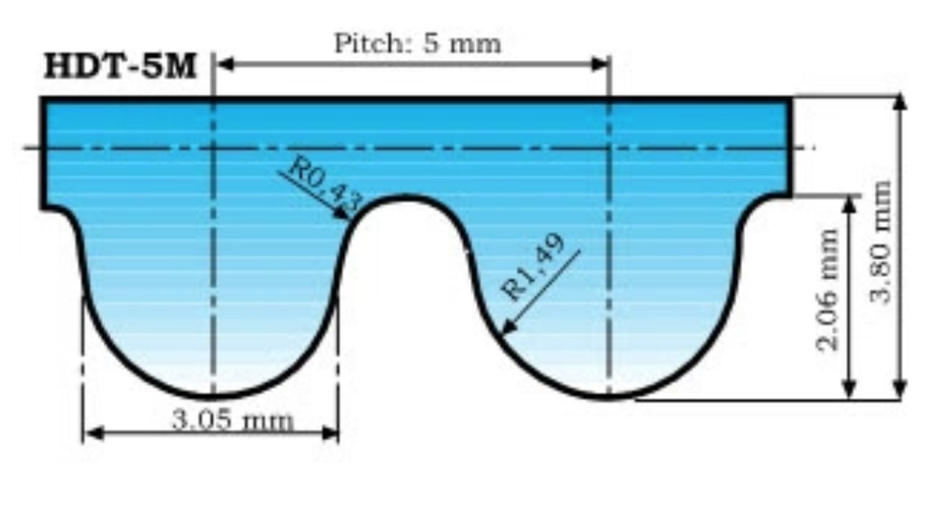
HTD5 Belt Profile
Pitch line assumed to be at mid-line of flat portion

Slide 3
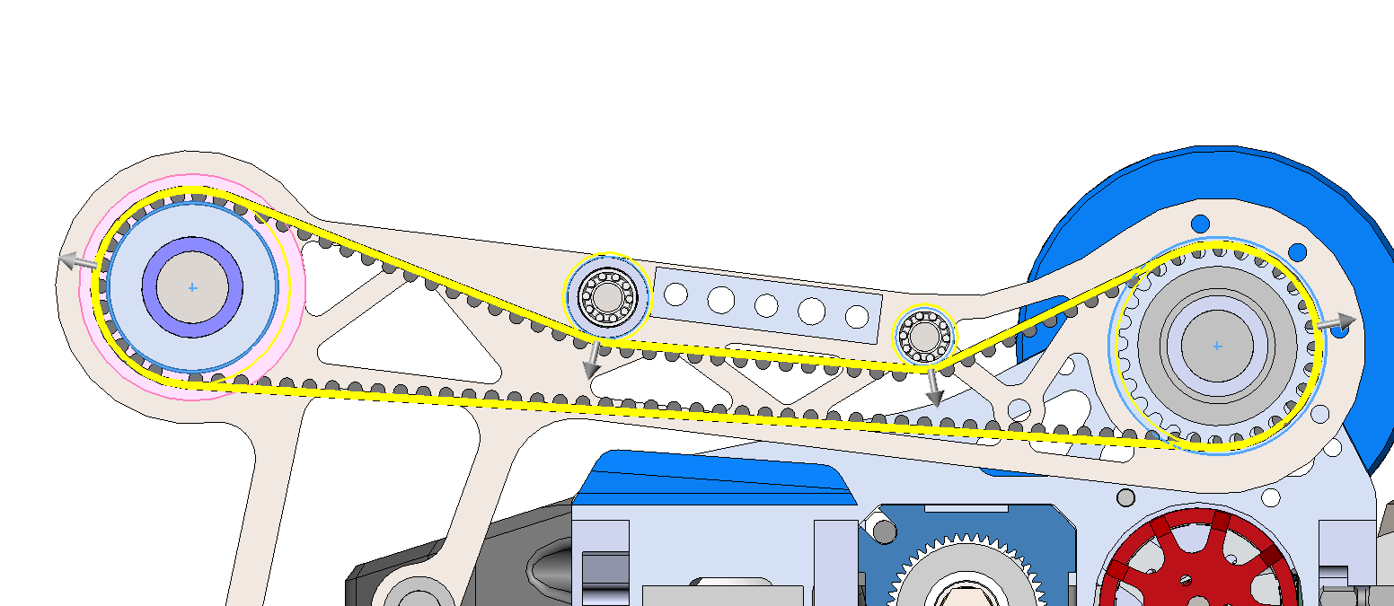
Diameters
Flat = 0.87 <- Flat to pitch diameter
Tooth = 2.06 <- tooth height
28t*5/pi
(pitch diameter calc for 28t)
37.06 + Tooth * 2 + Flat*2
18 + Flat*2
12.7 + Flat*2
42.92mm

Slide 4
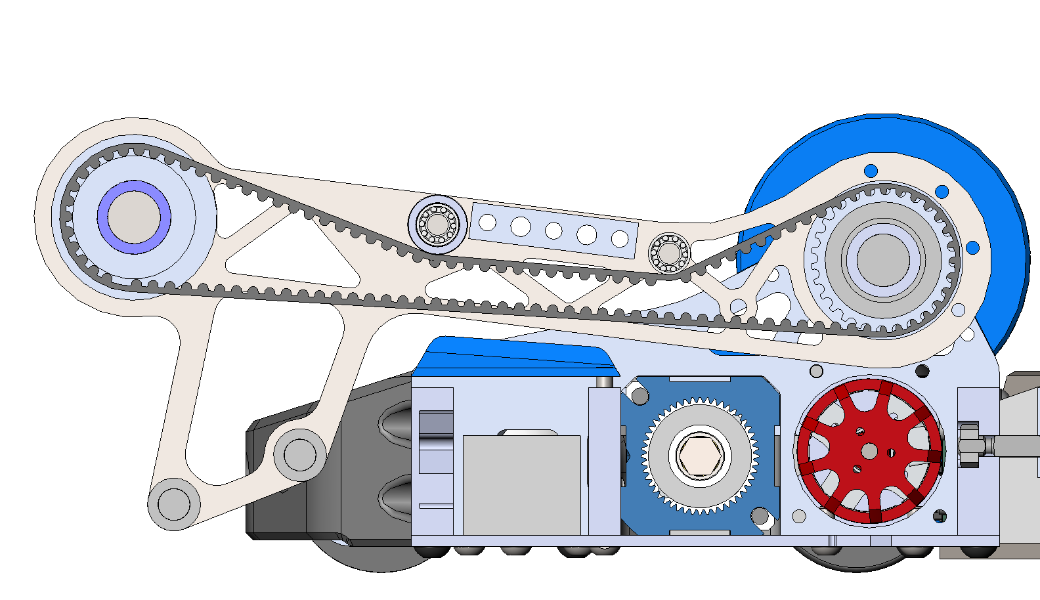
Nominal
Tooth touch-off condition on smooth pulley
Belt pitch length = 599.61mm

Slide 5
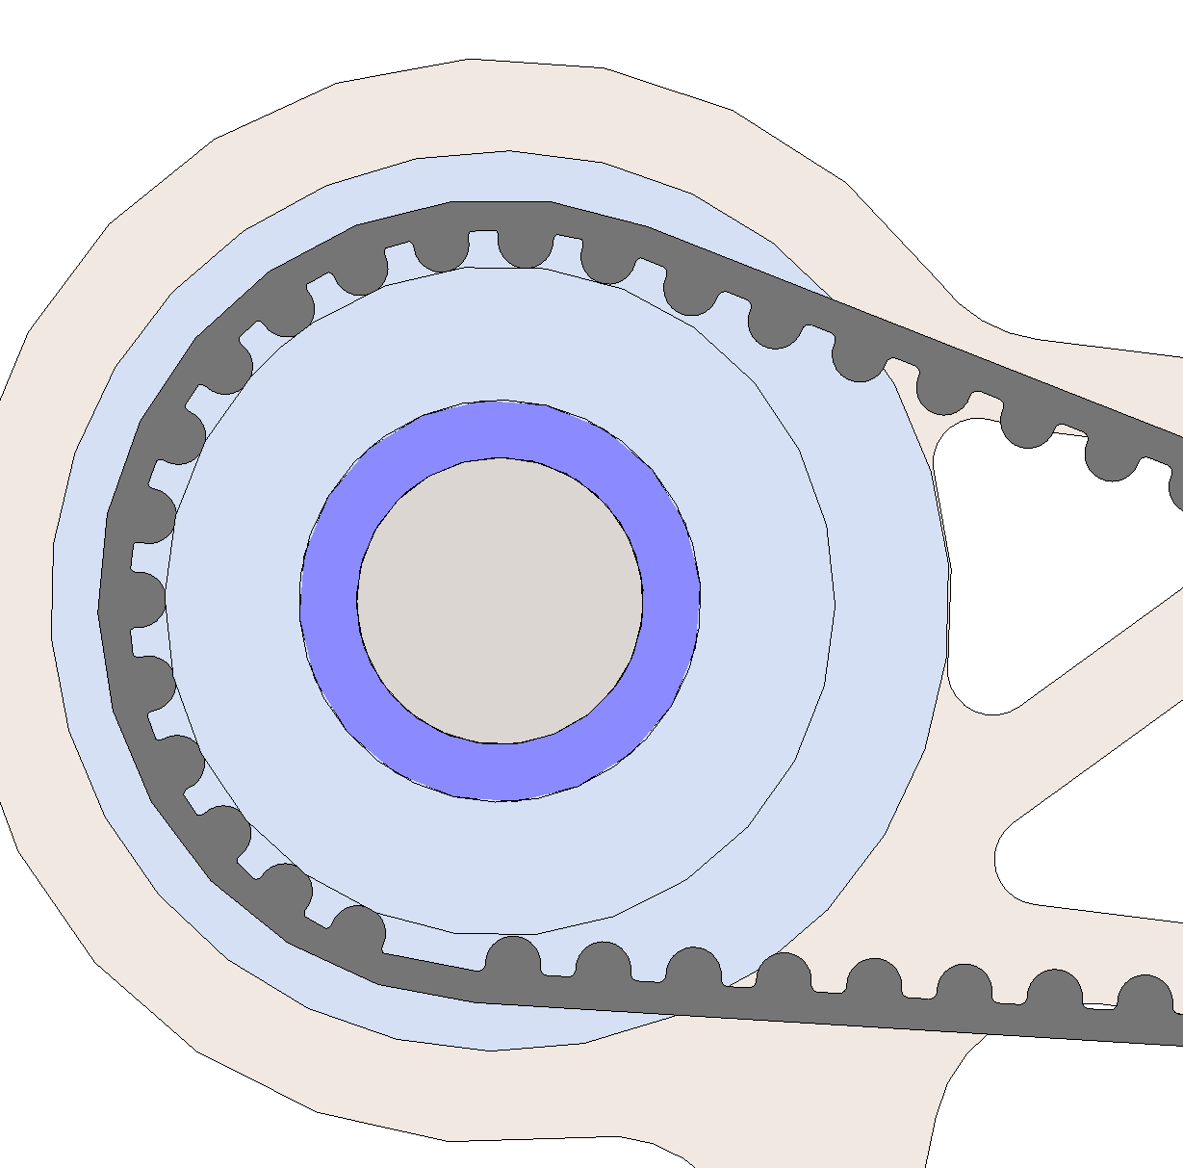
Tooth wear: 0.1mm
Belt pitch length = 599.27mm

Slide 6
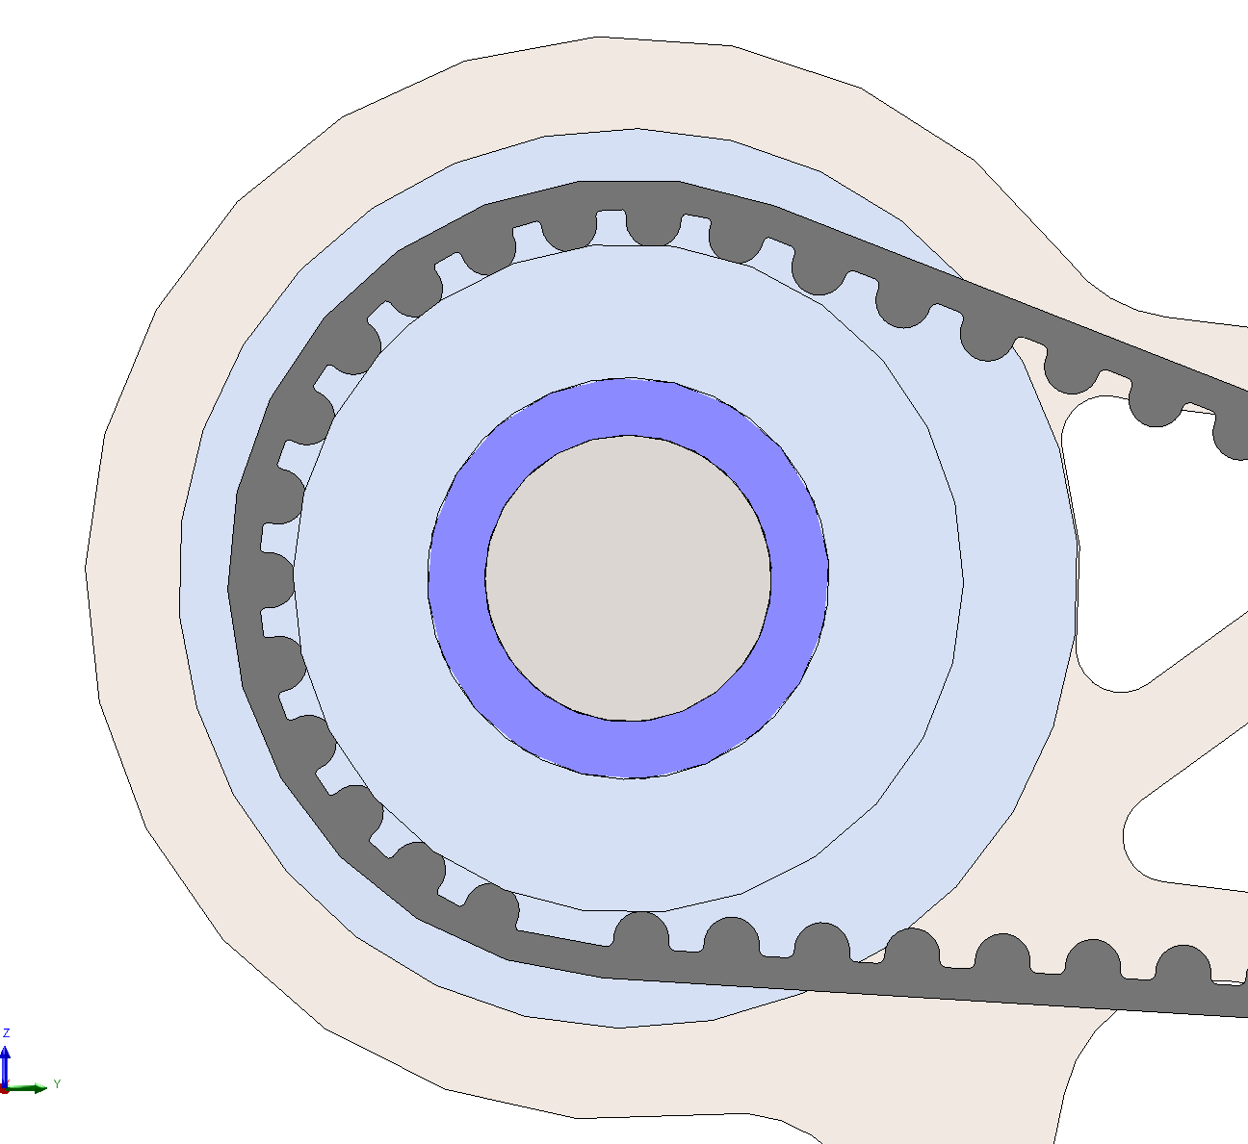
Tooth wear: 0.2mm
Belt pitch length = 598.92mm

Slide 7
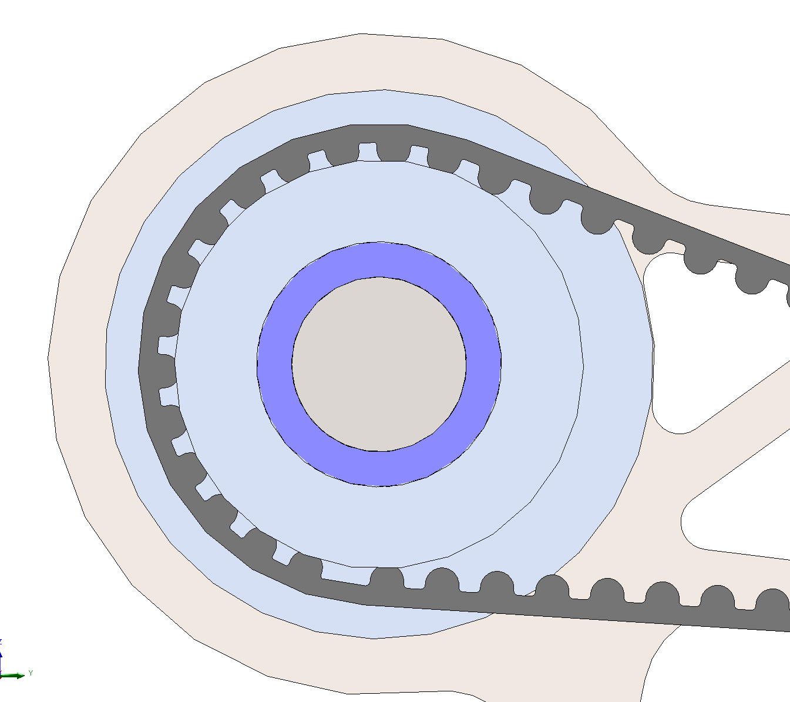
Tooth wear: .5mm
Belt pitch length = 597.89mm

Slide 8
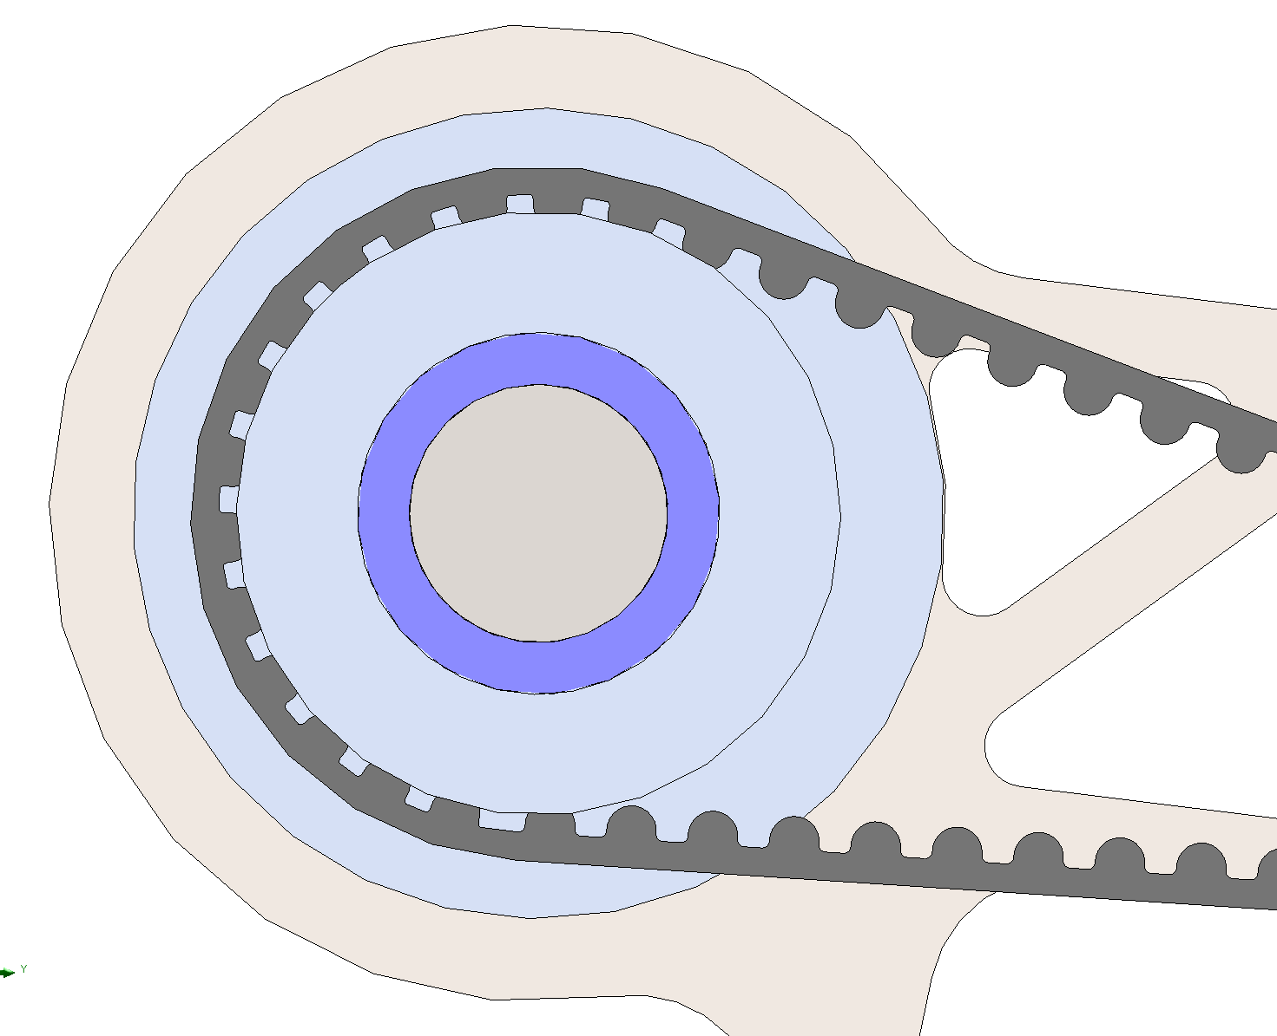
Tooth wear: 1mm
Belt pitch length = 596.17mm

Slide 9
Conclusion
Need to be adjustable up to a at least few mm to accommodate for belt wear worst-cases

